Slide 1
Sentiment Analysis on Self driving car reviews on twitter
-Supervised learning as my dataset contains labels

Slide 2
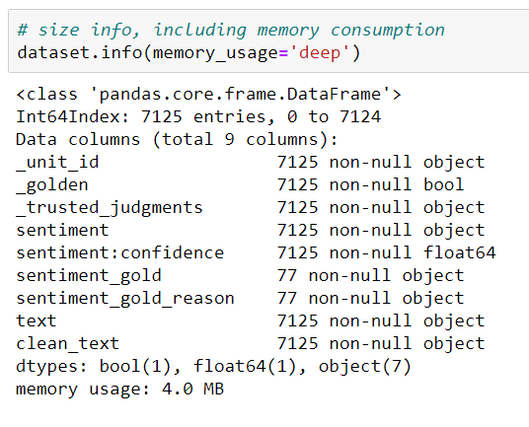
Knowing the dataset
Twitter dataset for self driving cars

Slide 3
Data cleaning process
Removal of Special characters & urls
Removal of white spaces
Removal of upper case letters
Tokenization of text
Lemmatization to get root word

Slide 4
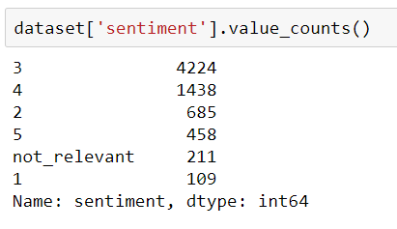
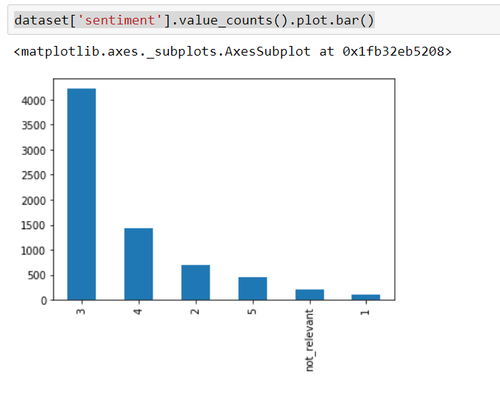
Is data balanced???

Slide 5
Feature Engineering
Use klearn feature extraction for generating Bag of words model
Visualize Vectors generated
Apply TF-IDF on result to generate weights of each words
Visualize using matplotlib which words are used most.
Apply Logistic regression model for learning.

Slide 6
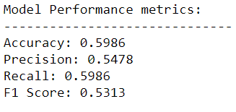
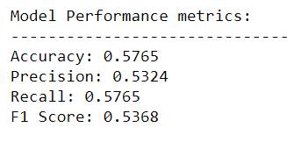
Bag of words model
Logistic Regression Model
Support Vector Machine Model

Slide 7
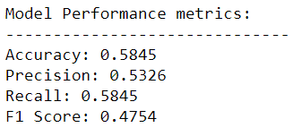
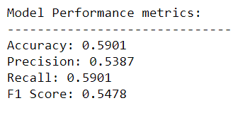
TF-IDF model
Logistic Regression Model
Support Vector Machine Model

Slide 8
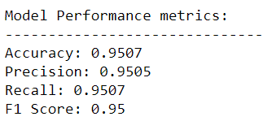
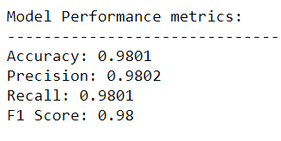
After Applying SMOTE
Smote is applied on top of tf-idf model
Logistic Regression Model
Support Vector Machine Model

Slide 9
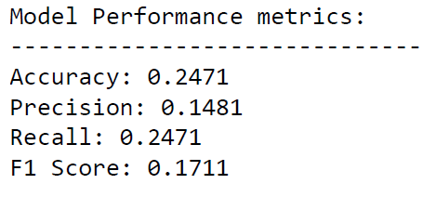
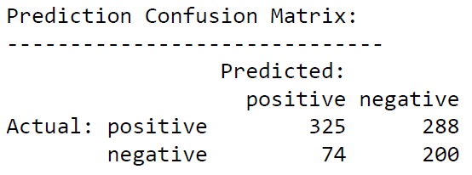
Unsupervised learning

Slide 10
Model Evaluation
We have total 12 models to compare before we apply ensemble learning.
We will first look at confusion matrix for all of our base model to select final base model.
To simplify, I would like to show only better models of each category.

Slide 11
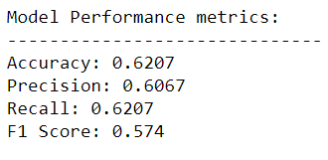
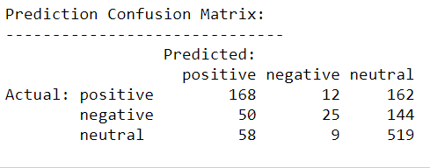
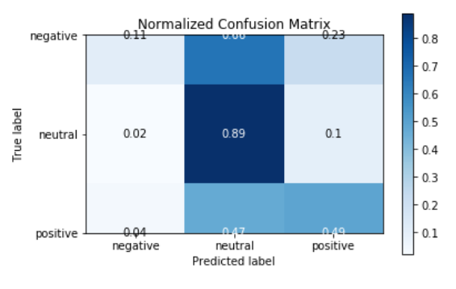
Bag of words model
Logistic regression

Slide 12
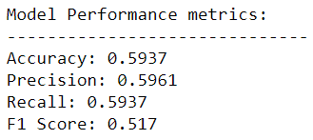
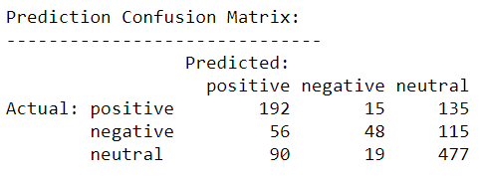
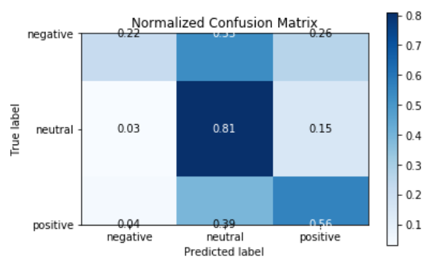
TF-IDF Model
Support Vector Machine Model

Slide 13
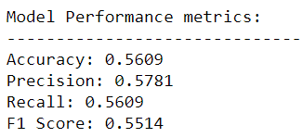
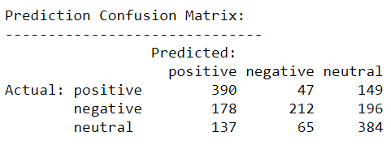
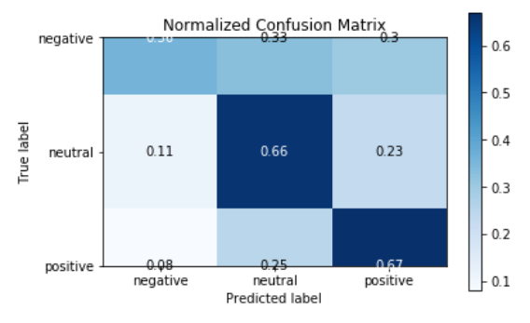
SMOTE OVER Sampling
Logistic Regression model

Slide 14
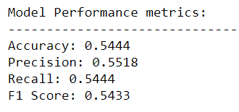
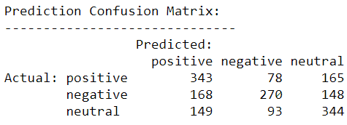
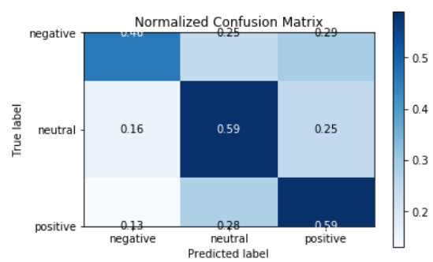
SMOTE under sampling
Support Vector Machine model

Slide 15
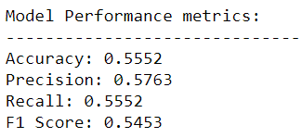
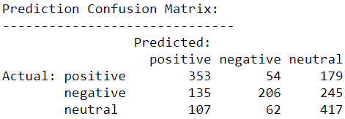
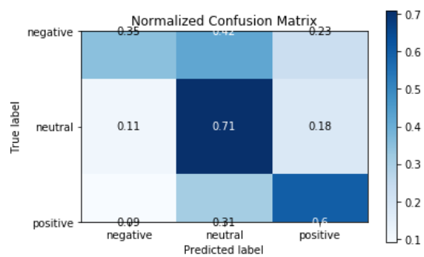
Random Over Sampling
Logistic regression model

Slide 16
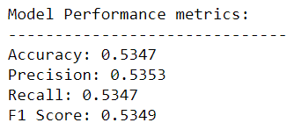
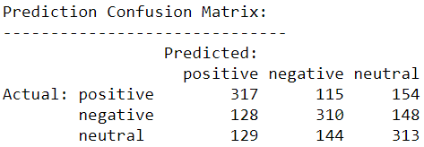
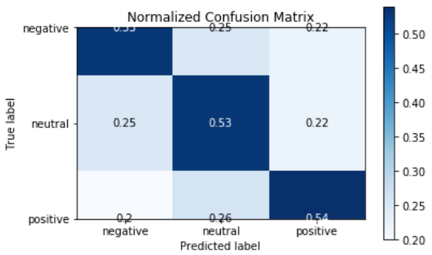
Random Under sampling
Support Vector Machine model

Slide 17
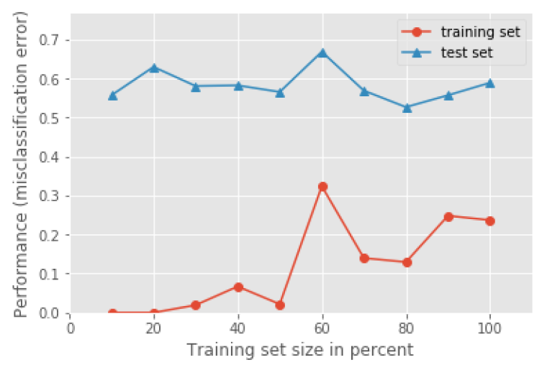
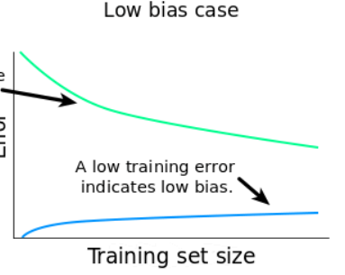
Learning Curve for RUS model

Slide 18
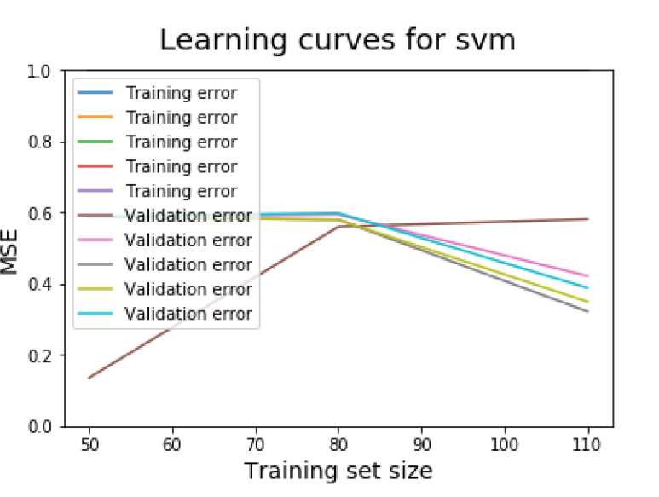
Learning Curve for all svm models

Slide 19
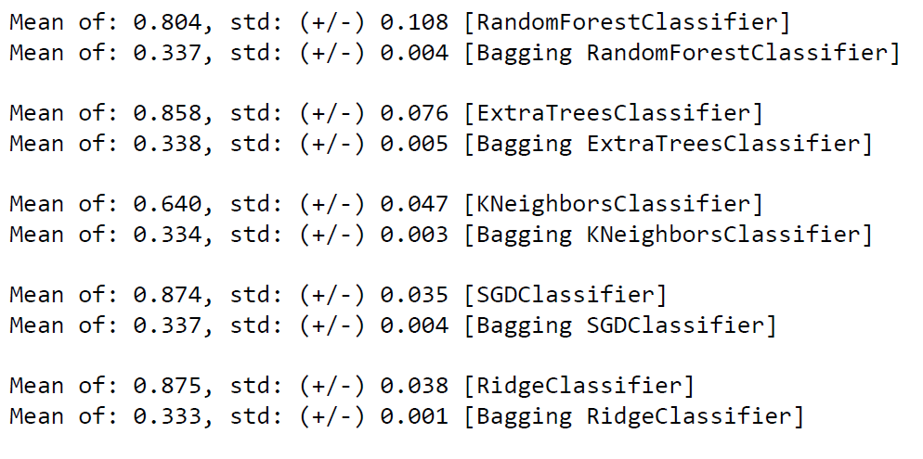
Ensemble Learning: Bagging

Slide 20
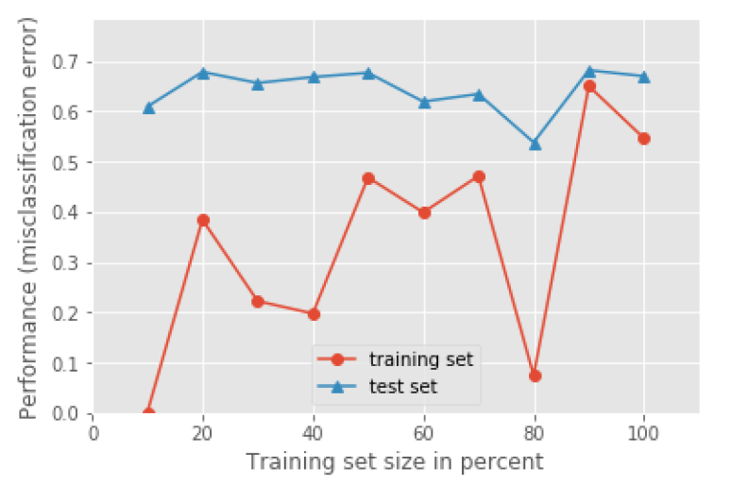
Learning Curve

Slide 21
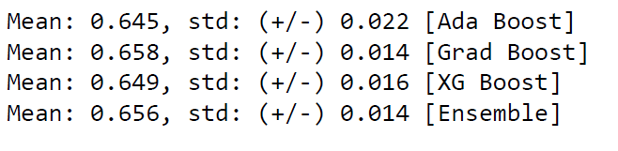
Ensemble learning: Boosting

Slide 22
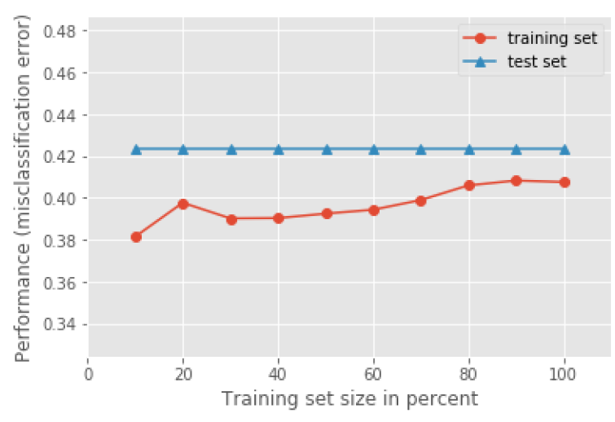
Learning curve after boosting

Slide 23
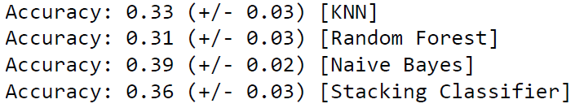
Ensemble Learning: Stacking

Slide 24
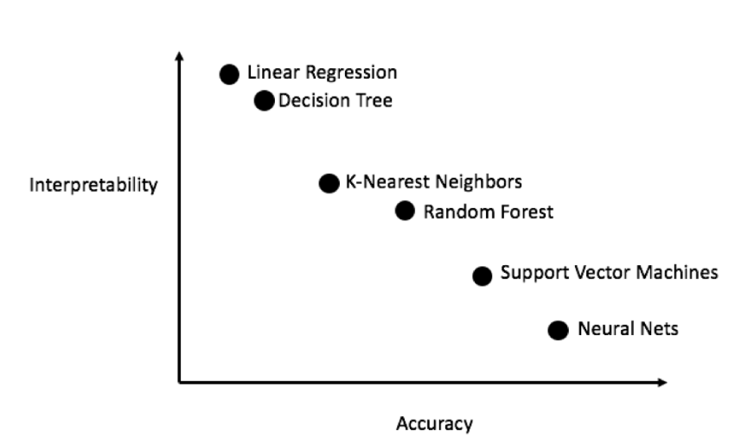
Interpretability

